Slide 1
Expanding the Museomics Toolkit
Nanopore Sequencing as a Tool for Methylation Mapping in Archival Corals
Kathleen Durkin,
SIFP Fellow, Summer 2025
University of Washington, School of Aquatic and Fishery Sciences
Notes:
Kathleen Durkin,
3rd year PhD student at UW, studying epigenetics in marine invertebrates
Past summer I completed a 10w SIFP fellowship at the Smithsonian NMNH

Slide 2
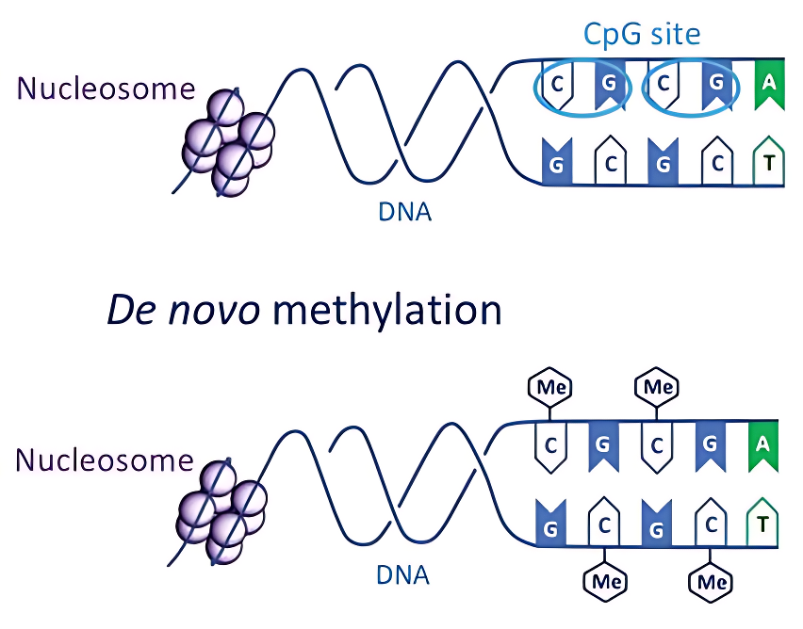
What is DNA methylation?
Cytosine + methyl group = 5mC
Influences expression and phenotype
Dynamic and responsive
Potentially heritable
https://www.intechopen.com/chapters/86433
Notes:
Before getting into the project details, let me give some quick background on DNA methylation for those less familiar with it.
Addition of methyl group to DNA nucleotides. In Eukaryotes, this most commonly occurs on Cytosine residues found in a “CpG dinucleotide context”, as seen in figure.
Epigenetic mechanism: Changes how genes are expressed without altering the underlying DNA sequence
Can be dynamically added and removed by specific modification enzymes in response to developmental or environmental shifts.
Potentially heritable in marine invertebrates, including corals

Slide 3
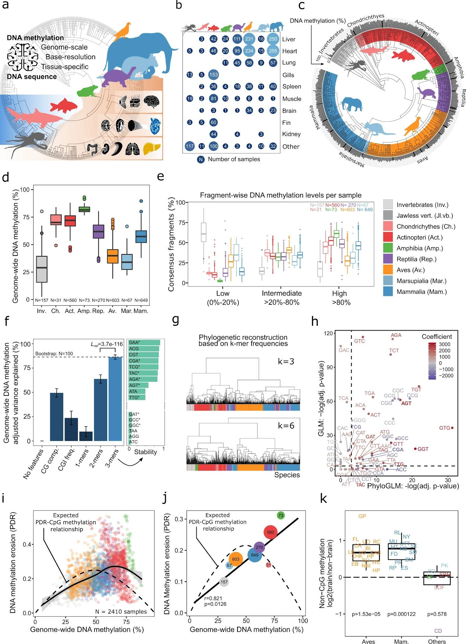
DNA methylation in marine inverts
Major differences between vertebrates and invertebrates. Inverts:
Low methylation level
Genomic distribution
Unclear mechanism
Key to invertebrate stress response, plasticity
Climate change!
Klughammer et al., 2023
Notes:
Major differences between vertebrates and invertebrates. Invertebrates generally have:
Lower global methylation levels (across the whole genome)
Different distribution patterns of methylation across genomic features
And a yet-unresolved mechanistic relationship with expression/phenotype
However, even though we don’t yet understand the mechanism of DNA methylation in invertebrates, we do know it’s key for stress response and acclimatization potential
Thus particularly relevant to understanding capacity for rapid environmental response, to evaluating differences in population resilience, etc.

Slide 4
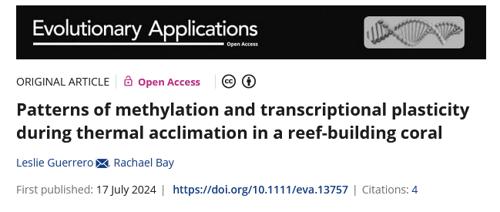
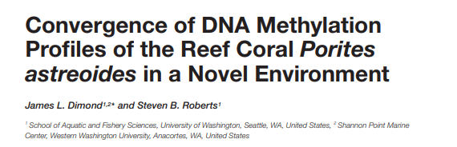
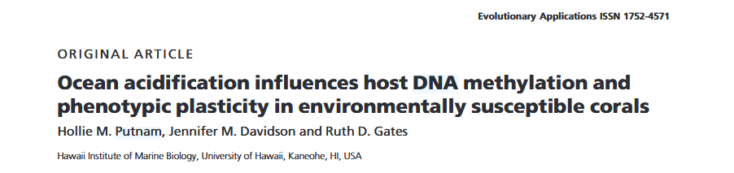
DNA methylation in marine inverts
Notes:
Excellent recent work examining DNA methylation in corals
These studies show methylation profiles shift in response to environmental changes, including transplantation, temperature stress, and ocean acidification
However, all of these use modern samples. That means we’re missing the historical perspective of what coral methylation looked like before the climate crisis began
This is where museum collections become invaluable

Slide 5
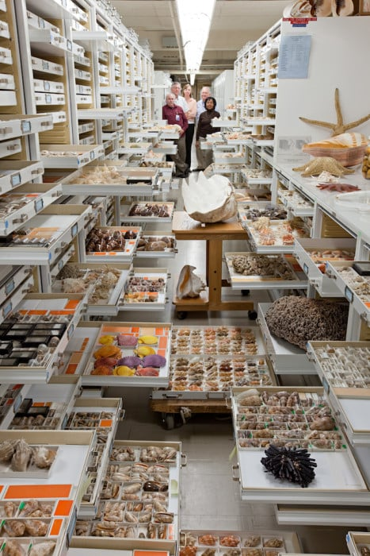

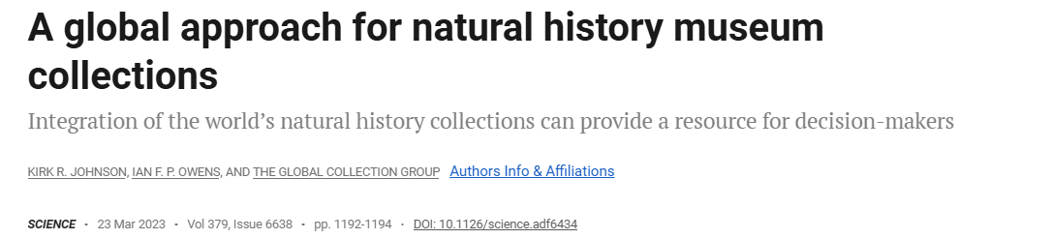
Benefits of using historical material
Huge amount of material available
No field sampling = less $, more accessible
Potential for examining historical states, pre-climate crisis
Notes:
Its recently been reported tha natural history museums hold over 1.1 billion specimens worldwide
many of those contain usable historical DNA (hDNA)
Underutilized resource
Eliminates field sampling (expensive, logistically challenging, time consuming, and potentially detrimental to vulnerable populations)
Snapshots of past biodiversity
Baseline for understanding how coral epigenomes may have shifted over past century of environmental change

Slide 6
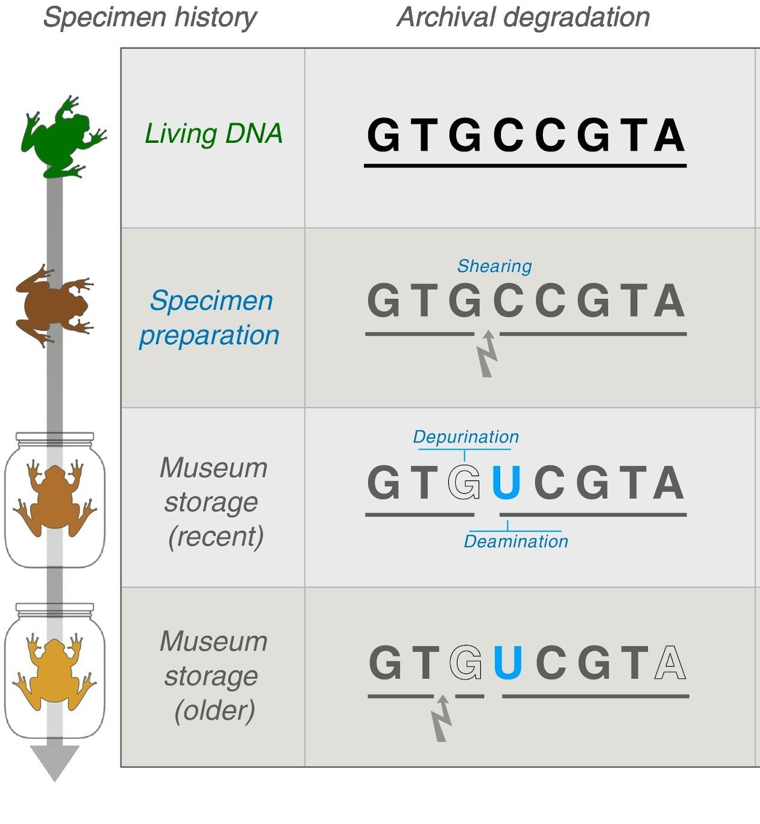
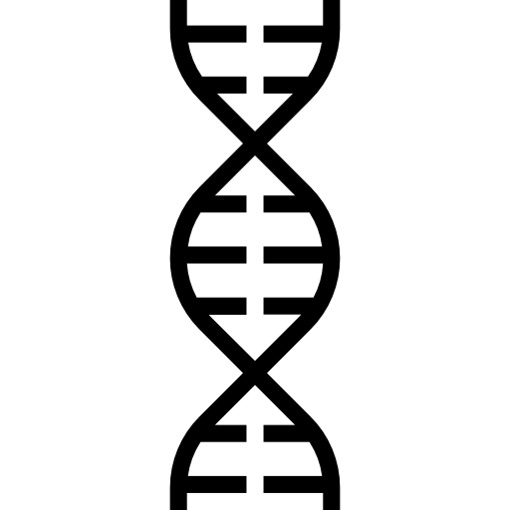
There are problems sequencing methylation from museum vouchers
Raxworthy & Smith (2021)
Notes:
Even under ideal storage conditions, DNA spontaneously degrades over time
Less HMW DNA, fragmentation, plus chemical reactions like deamination lead to base modifications
Ex. C loses amino group (deaminates), becoming a U, which is then read as a thymine after sequencing.
Particularly problematic for methylation work because methylated cytosines deaminate directly to thymine and are also sequenced as such, which means deamination can lead to “false negatives”

Slide 7
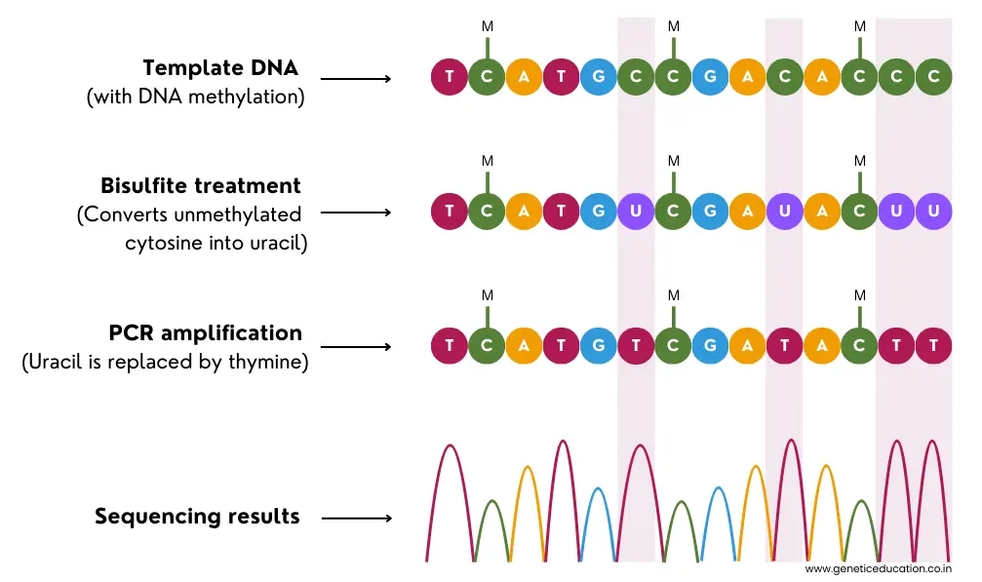
WGBS is ill-suited to hDNA sequenicng
Notes:
Standard is WGBS
Workflow shown here, use bisulfite treatment to convert unmethylated Cs to Us, then sequence. Remaining Cs represent methylated positions.
BUT
WGBS is very harsh, with the bisulfite conversion heavily fragmenting DNA in the process, so not ideal for working with low quality/quantity input
Additionally, nucleotide transformations (via bisulfite treatment and via PCR) may mask indicators of age-related deamination and original methylation status
With historic samples, which may have high rates of deamination, this could lead to systematic underestimation of methylation

Slide 8
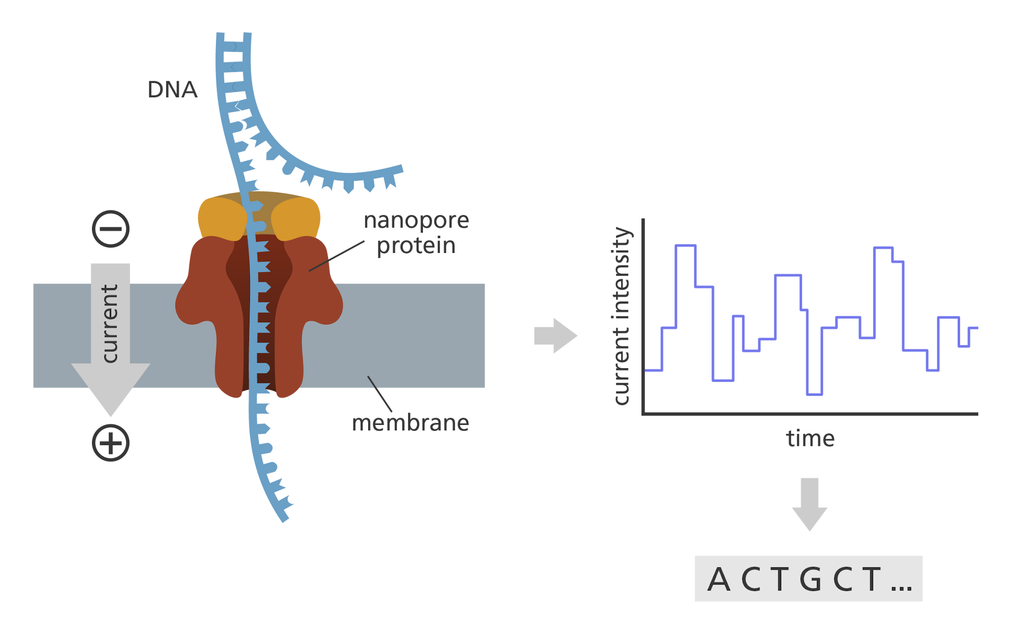
Nanopore may offer better alternative for hDNA methylation mapping
Requires less input DNA
No harsh bisulfite conversion
Can ID multiple modification types (5mC, 5hmC, 6mA, 4mC)
https://www.yourgenome.org/theme/what-is-oxford-nanopore-technology-ont-sequencing/
Notes:
Nanoopre is fundamentally different approach
Reads DNA by directly measuring electrical current as molecule is fed through a protein pore
advantages
Requires less input DNA
Can ID multiple forms of DNA modification (5mC, 5hmC, 6mA, 4mC)
No bisulfite conversion (damaging) or amplification (introduces nucleotide conversions)
Potential to provide more accurate methylation mapping in samples with age-related deamination signatures

Slide 9
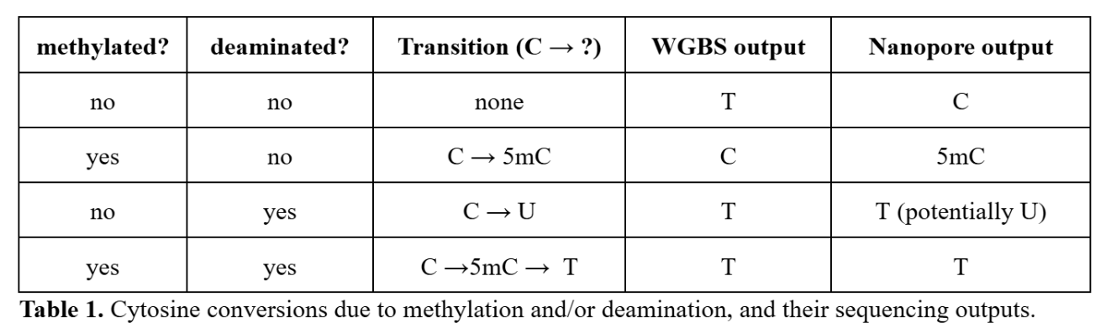
Deamination in WGBS v. Nanopore
Notes:
Consider 4 possible states of a cytosine in historic DNA.
WGBS: 3/4 states return Thymines, meaning only intact methylated Cs are distinguishable
Nanopore: can theoretically distinguish more of these states.
Nanopore has also now announced they can detect genomic uracil directly, which would further improve discrimination, but those methods have yet to be released

Slide 10
Project Goal:
Benchmark ONT nanopore direct sequencing as a tool for mapping DNA methylation in archival specimens of coral.

Slide 11
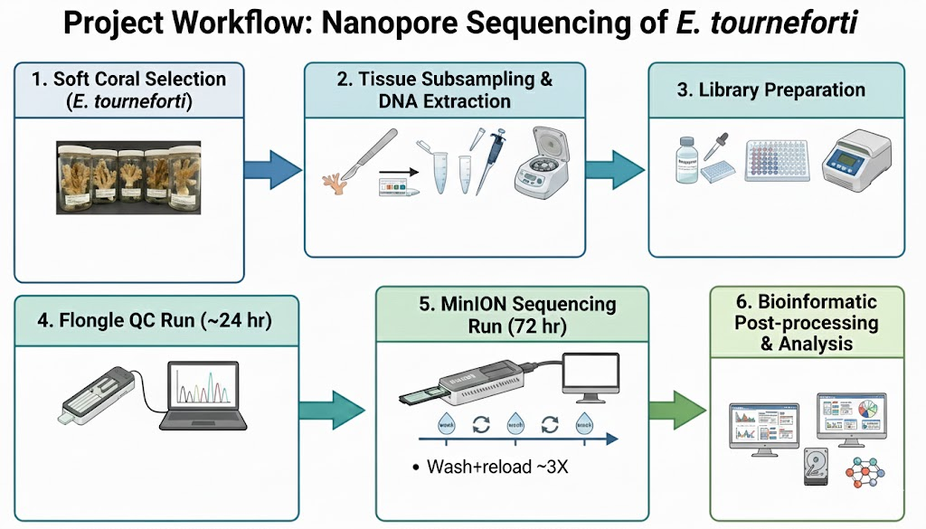
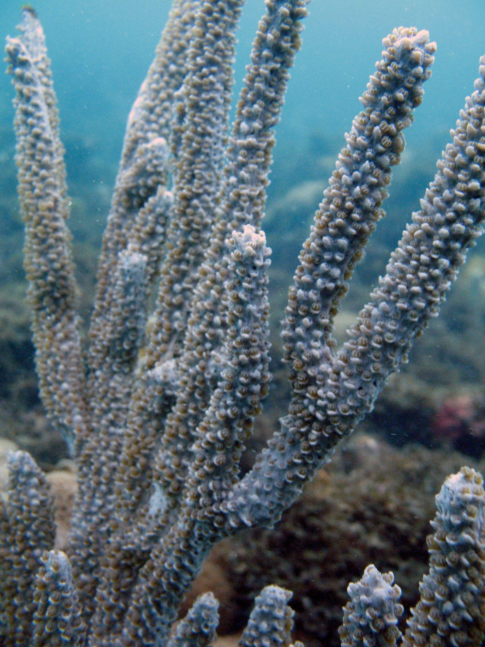
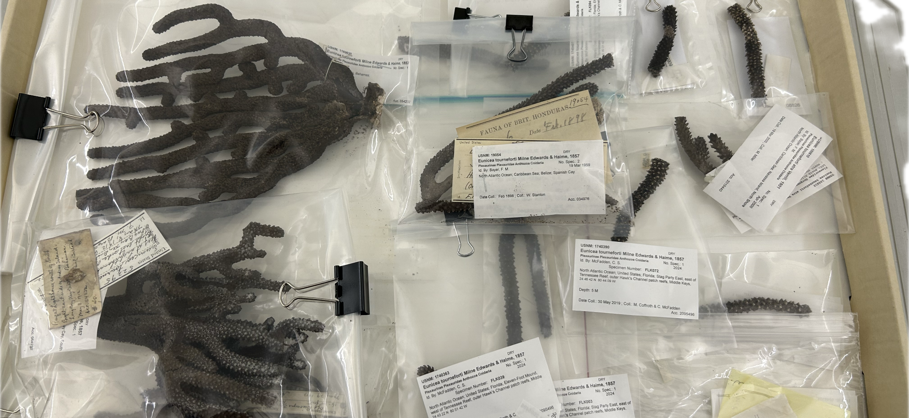
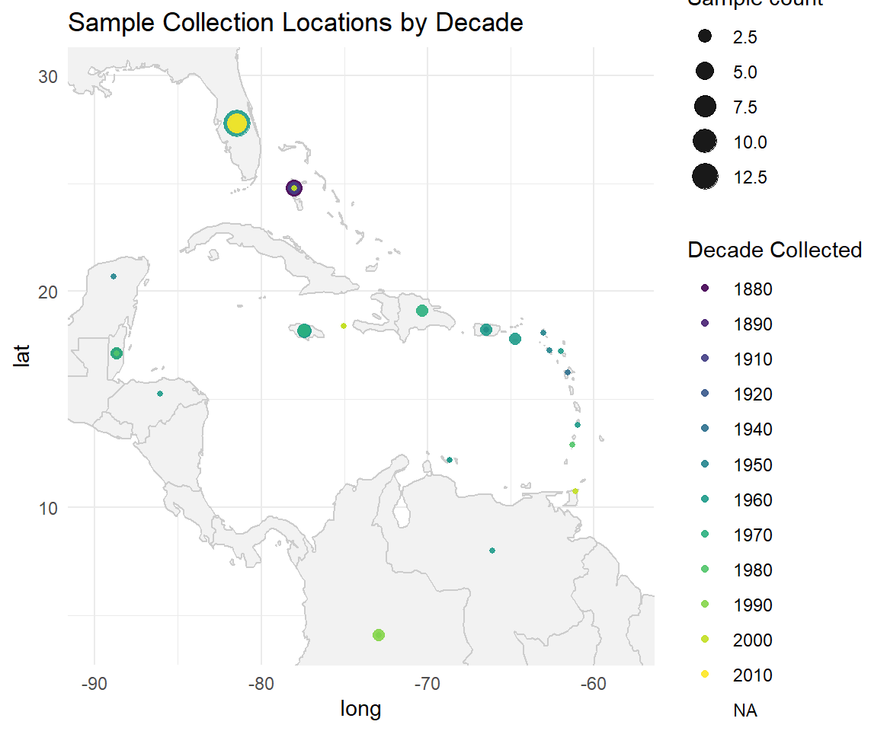
Large # of dried vouchers
Appropriate age range
Genome for close relative
https://nsuworks.nova.edu/octocoral_all/186/
Notes:
Selected the caribbean octocoral Eunicea tournefortii, which is widely distributed throughout the Caribbean and Bahamas
Museum had relatively high # of dried samples
Had >5 vouchers each from >100yo, ~50yo, and w/in last 20 year (modern ref)
High quality genome for Eunciea knighti

Slide 12
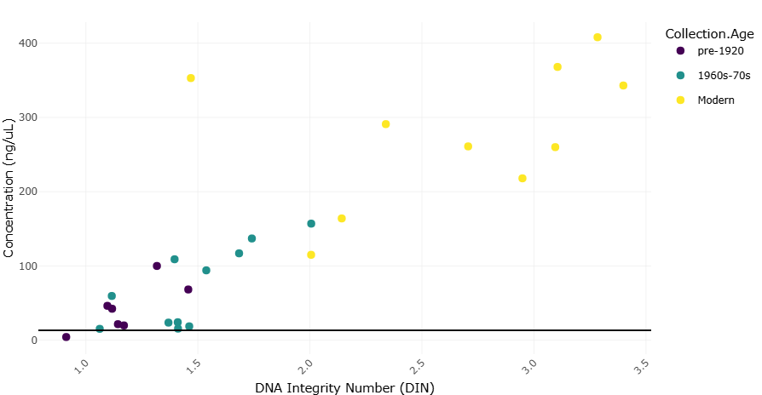
Large # of dried vouchers
Appropriate age range
Genome for close relative
Qiagen extractions
Bead cleans
n=3, N=9
Notes:
As expected, extractions had a clear relationship of both DNA quantity and quality with collection date.
While we originally planned to include 5 vouchers in each of the three collection ranges (>100yo, ~50 yo, modern), ended up switching to n=3 due to coverage limitations

Slide 13
Large # of dried vouchers
Appropriate age range
Genome for close relative
Qiagen extractions
Bead cleans
n=3, N=9
ONT Native Barcoding Kit 96
Notes:
Library Preparation: ONT Native Barcoding 96 (no amp, so preserves modifications)
Barcoding several samples on a single flow cell allowed us to reduce per-sample cost while still hopefully meeting coverage requirements

Slide 14
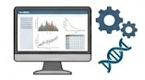
Large # of dried vouchers
Appropriate age range
Genome for close relative
Qiagen extractions
Bead cleans
n=3, N=9
ONT Native Barcoding Kit 96
Wash + reload 3X
Confirm successful library prep
QC samples (e.g. for exogenous DNA)
5 runs total (hDNA specimens sequenced twice)
Notes:
The flow cells – consumable parts used during a sequencing run – are expensive, so
used Flongles (mini flow cells) to confirm library prep and asses sample quality (e.g., check for contamination)

Slide 15
Large # of dried vouchers
Appropriate age range
Genome for close relative
Qiagen extractions
Bead cleans
n=3, N=9
ONT Native Barcoding Kit 96
Wash + reload 3X
Confirm successful library prep
QC samples (e.g. for exogenous DNA)
5 runs total (hDNA specimens sequenced twice)
Notes:
Full sequencing with MinION flow cells, including several wash/reload cycles to maximize output
5 runs total, with historic and mid-age samples sequenced twice to increase coverage.

Slide 16
Large # of dried vouchers
Appropriate age range
Genome for close relative
Qiagen extractions
Bead cleans
n=3, N=9
ONT Native Barcoding Kit 96
Wash + reload 3X
Confirm successful library prep
QC samples (e.g. for exogenous DNA)
5 runs total (hDNA specimens sequenced twice)
Notes:
Modified basecalling on nanopore outputs
Generation modification summary files, etc.

Slide 17
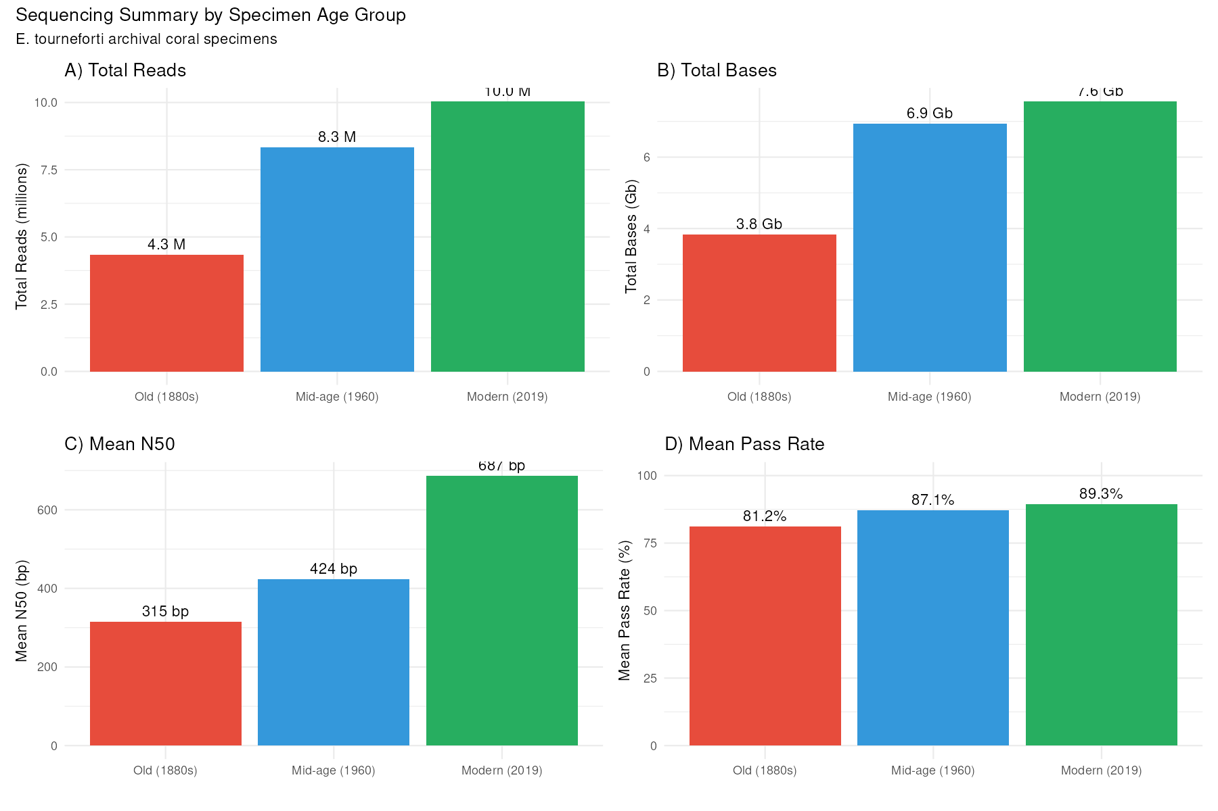
Notes:
Important to note that, for the Oldest and Mid-age age groups, the output shown here represents the cumulative output across two iterations of library prep and MinIONsequencing, due to low output. Even with “doubling” the output, there are still dramatic differences in output (both read- and base-level) based on sample age, and the sample quality differences are also apparent in the N50 differences. One upside, though, is that there isn’t much difference in the mean pass rate, which represents the proportion of sequenced reads that meet a minimum quality threshold. That means that, while less is sequenced from old samples, even when comparable library quantities are loaded, what is sequenced is still sufficiently high-quality to be usable.
Some other notes:
Flongles are useful for sample QC, but flow cell quality was a problem, so value for data output is limited
Nanopore is still not well optimized for non-model specimens, and output (both Flongle and MinION) was very low even for the modern samples
we consequently reduced # of samples
Actually double-sequenced the mid-age and oldest age group samples (two sequencing runs)
Still have extremely low coverage (average of 1-2X across whole genome for all specimens), so very limited in ability to confidently call individual CpG site methylation
However, can still discuss global-level!
Alignment 50-80% across runs.

Slide 18
Sequencing takeaways
Flongles were useful for sample QC, but flow cell quality was a problem, so value for data generation is limited
Nanopore is still not well optimized for non-model species, and output (both Flongle and MinION) was much lower than commonly reported levels, even for the modern samples
Alignment 50-80% across runs.
Once QC’d and mapped to genome, global coverage is 1-3X for each sample
Notes:
A few key takeaways from the sequencing phase

Slide 19
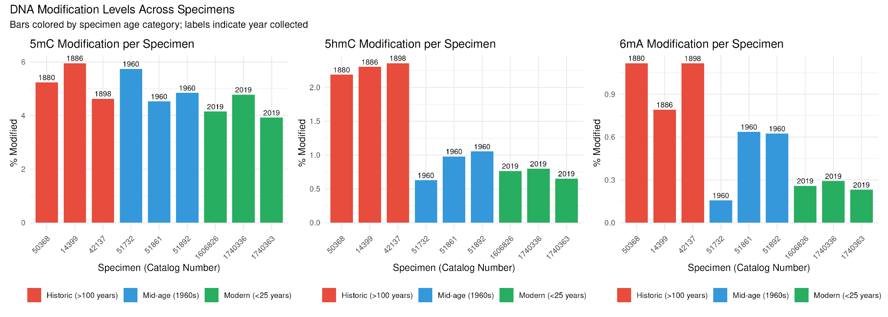
The methylation data!
Global methylation level is in line with other corals – nice!
Some variation among age classes
Upon further investigation, there is actually variable prevelance of additional modifications among age classes – older specimens = more modifications
Notes:
Excitging part – methylation!
"We successfully detected 5mC methylation across all specimen age categories, with levels in the 4-6% range typical for invertebrates.
Importantly, don't see a systematic decline in detected methylation with specimen age,
suggests nanopore approach can recover methylation signals from historic DNA.
We also examined 5hmC and 6mA calls, which are modifications rarely found in eukaryotes. As expected, these are likely spurious—note that the historic specimens show elevated levels compared to modern samples, suggesting these 'modifications' may actually reflect DNA damage patterns or microbial contamination that accumulates over time. This gives us a potential proxy for assessing DNA damage alongside our deamination analysis."

Slide 20
Takeaways/Next steps:
Nanopore can be used to sequence DNA modifications in archival material, but it is not well-optimized and thus not cost-efficient
An unforeseen result, Nanopore sequencing reports accumulation of rare modifications in older/more degraded samples, potentially serving as useful indicators of DNA damage in future work
Annotate genome to generate feature-level methylation summaries
Disentangle deamination signals
Pool samples by collection age group to up coverage for comparison across time point

Slide 21
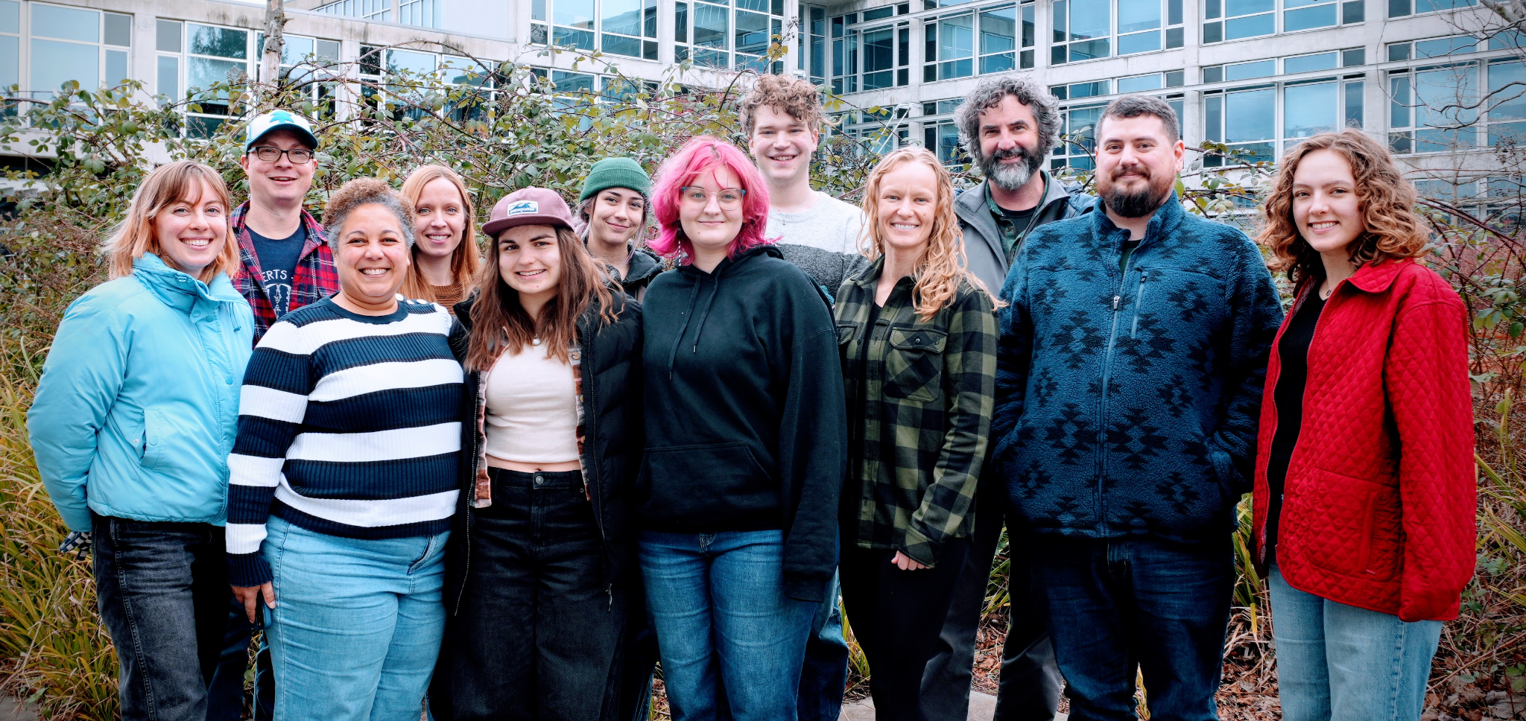

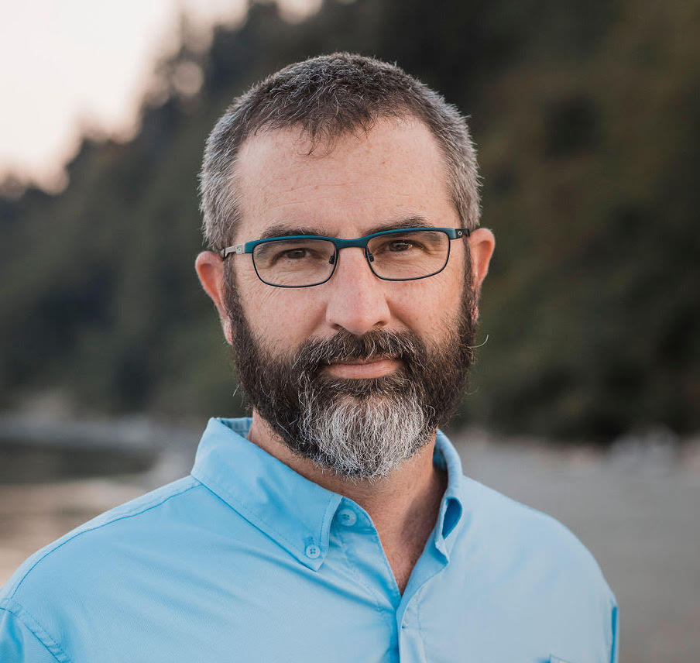

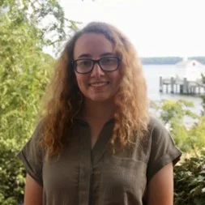

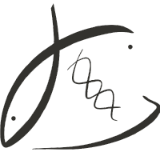



Thank you!
Steven Roberts
Ariana Huffmeyer
Jill Ashey
Sam White
Roberts
Lab
Andrea Quattrini & Quattrini Lab
Katie Murphy
Dan MacGuigan
The Roberts Lab
My Lab Notebook

Slide 22
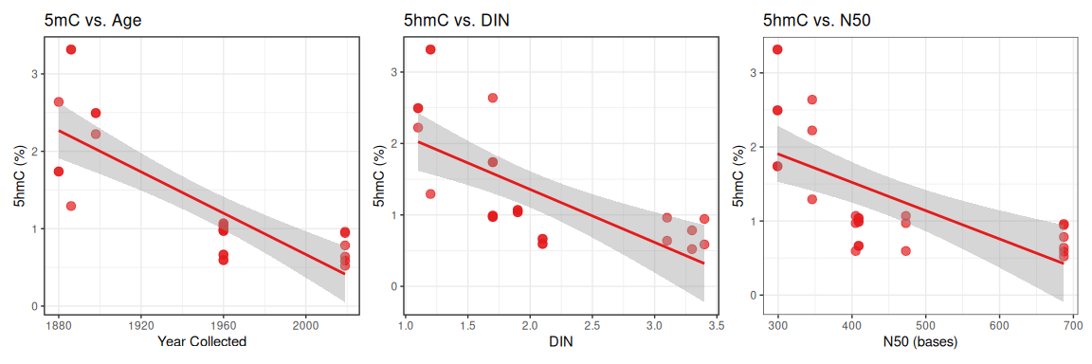
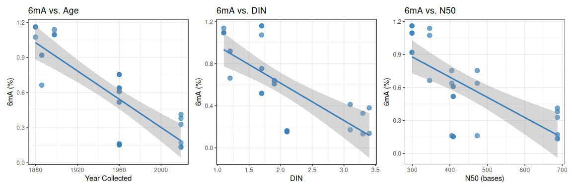

Slide 23
Expanding the Museomics Toolkit: Assessing Nanopore Sequencing as a Tool for Methylation Mapping in Archival Corals
Museum specimens offer unique opportunities to study epigenetic changes across environmental history, yet methodological limitations have inhibited DNA methylation analysis in degraded historic samples. This study represents the first application of Oxford Nanopore direct sequencing to map methylation patterns in archival invertebrate specimens, using Caribbean octocorals (Eunicea tourneforti) spanning 130 years (1880s-2010s). We extracted DNA from 28 dried museum specimens across three temporal groups and performed MinION sequencing to evaluate detection of 5-methylcytosine modifications. This methodological development expands capabilities for studying epigenomic responses to environmental change in museum collections, with potential implications for understanding coral resilience mechanisms and informing conservation strategies for climate-threatened reef ecosystems.

